Slide 1
Software Construction Laboratory CS35L – Lab 1
Course Webpage: https://web.cs.ucla.edu/classes/fall18/cs35L/index.html
TA: Zhiyi Zhang
Email: zhiyi@cs.ucla.edu
Webpage: https://zhiyi-zhang.com

Slide 2
What’s this class about?
“Fundamentals of commonly used software tools and environments, particularly open-source tools to be used in upper division computer science courses.”

Slide 3
Syllabus
50% homeworks
10 assignments
Late penalty
50% final exam
More details: https://web.cs.ucla.edu/classes/fall18/cs35L/grading.html

Slide 4
About Lab
No drink and food is allowed
Please log out when you leave the lab

Slide 5
About Assignments
Assignment 7
Require Seeed Studio BeagleBone Wireless Development Board
Assignment 10
Research news read and presentation
Team of two students
Start team sign up from week 3
Start presentation from week 4
Topic first come first serve :D

Slide 6
About PTE
Come to me after class
Name and UID
Email address
Major
Which TA Session

Slide 7
Session 1-1
Open source software
Linux OS
Basics of Linux OS

Slide 8
What is open source software?
Source code is publicly available
Anyone is allowed to modify the source code
Examples
Linux, Chromium, Firefox, Android
Popular websites for open source software release
SourceForge, GitHub, GitLab, Apache
Notes:
Open-source software (OSS) is a type of computer software whose source code is released under a license in which the copyright holder grants users the rights to study, change, and distribute the software to anyone and for any purpose.

Slide 9
GNU/Linux
Open-source operating system
Kernel: core of operating system
Allocates time and memory to programs
Handles file system and communication between software and hardware
Shell: interface between user and kernel
Interprets commands user types in
Takes necessary action to cause commands to be carried out
Programs
Notes:
GNU /ɡnuː/ ( listen) is an operating system and an extensive collection of computer software. GNU is composed wholly of free software, most of which is licensed under the GNU Project's own General Public License (GPL).
GNU is a recursive acronym for "GNU's Not Unix!", chosen because GNU's design is Unix-like, but differs from Unix by being free software and containing no Unix code. The GNU project includes an operating system kernel, GNU HURD, which was the original focus of the Free Software Foundation (FSF).However, non-GNU kernels, most famously Linux, can also be used with GNU software; as the Hurd kernel is not yet production-ready,^{[20]} this is how the GNU system is usually used. The combination of GNU software and the Linux kernel is commonly known as Linux.

Slide 10
CLI v.s. GUI
CLI (Command Line Interface)
Steep learning curve
Pure control
Cumbersome multitasking
Convenient remote access
Faster performance and less recourses
GUI (Graphic User Interface)
Ease of use and visually intuitive
Easy multitasking
Bulky remote access
Slower
More recourses

Slide 11
The Basics: Shell
<up arrow>: previous command
<tab>: auto-complete
!!: replace with previous command
![str]: refer to previous command with str
^[str]: replace with command referred to as str

Slide 12
Files and Processes
Everything is either a process or a file:
Process: an executing program identified by PID
File: collection of data
A document
Text of program written in high-level language
Executable
Directory
Devices

Slide 13
Linux File System Layout
Tree structured hierarchy
/
root
bin
dev
home
usr
tmp
lakers
celtics
bulls
lib
README
music
doc
game1
game2
Notes:
Each file is under a directory.
A directory is also a file.
Only one root “/”.
Regular files can only be leaves.
e.g., documents, music, etc.

Slide 14
Absolute Path vs. Relative Path
/
root
bin
dev
home
usr
tmp
lakers
celtics
bulls
lib
README
music
doc
game1
game2

Slide 15
The Basics: Moving Around
pwd: print working directory
cd: change directory
~ home directory
. current directory
/ root directory, or directory separator
.. parent directory

Slide 16
The Basics: Dealing with Files
mv: move/rename a file
cp: copy a file
rm: remove a file
r: remove directories and their contents recursively
mkdir: make a directory
rmdir: remove an empty directory
ls: list contents of a directory
d: list only directories
a: list all files including hidden ones
l: show long listing including permission info
s: show size of each file, in blocks

Slide 17
The Basics: Changing File Attributes
ln: create a link
Hard links: point to physical data
Soft links aka symbolic links (-s): point to a file
touch: update access & modification time to current time
touch filename
touch -t 201101311759.30 filename
Change filename’s access & modification time to (year 2011 January day 31 time 17:59:30)

Slide 18
Hard
Notes:
The inode is a data structure in a Unix-style file systemwhich describes a filesystem object such as a file or a directory. Each inode stores the attributes and disk block location(s) of the object’s data.
Filesystem object attributes may include metadata (times of last change,[2]access, modification), as well as owner and permission data.
Create two files
$ touch blah1 $ touch blah2
Fill contents into the files and print them
$ echo "Cat" > blah1 $ echo "Dog" > blah2
$cat blah1; cat blah2
Cat
Dog
Create links
$ ln blah1 blah1-hard $ ln -s blah2 blah2-soft $ ls –l
blah1 blah1-hard blah2 blah2-soft -> blah2
Change the original file
$ mv blah1 blah1-new $ cat blah1-hard
Cat
$ mv blah2 blah2-new $ cat blah2-soft
cat: blah2-soft: No such file or directory

Slide 19
Linux File Permissions
Notes:
- : regular file.
d : directory.
c : character device file.
b : block device file.
s : local socket file.
p : named pipe.
l : symbolic link.

Slide 20
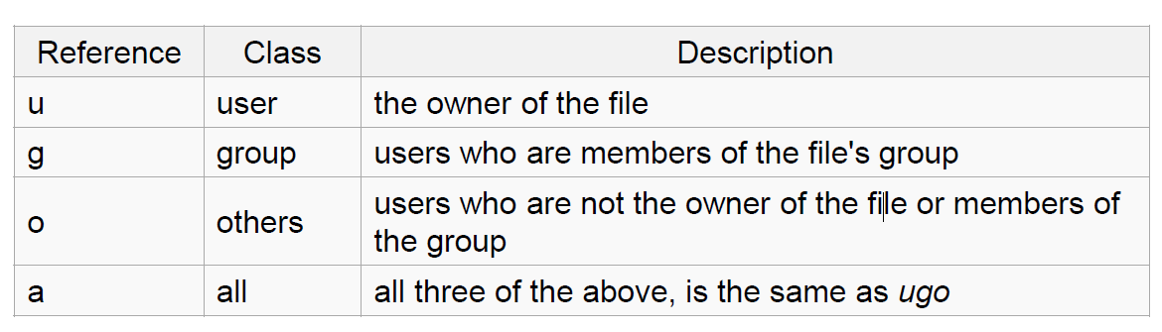
Linux File Permissions
chmod
read (r), write (w), executable (x)
User, group, others

Slide 21
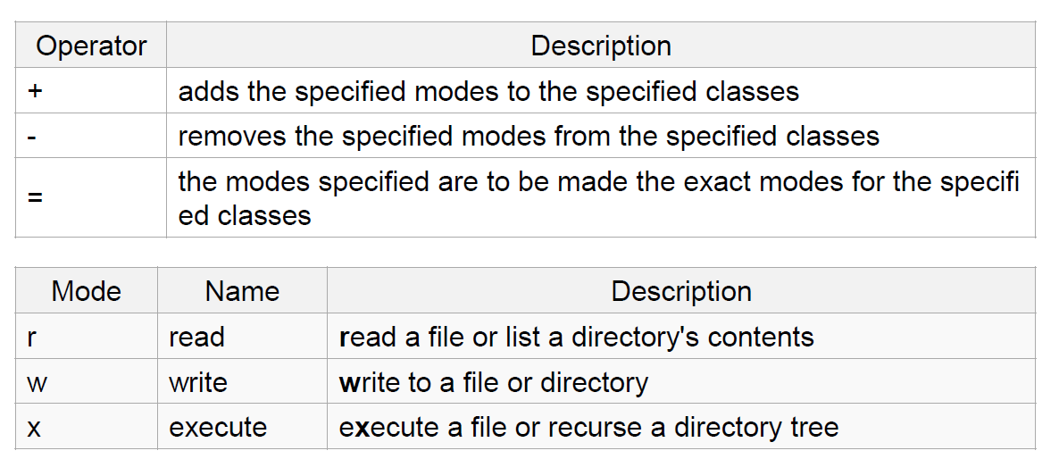
The Basics: chmod (symbolic)

Slide 22
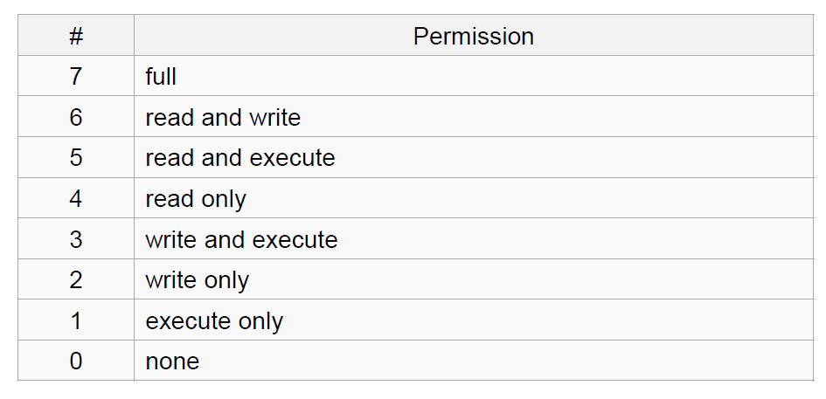
The Basics: chmod (numeric)
Notes:
Usage
– chmod [''references''][''operator''][''modes''] ''file1'' ...
chmod ug+rw mydir,
chmod a-w myfile,
chmod ug=rx mydir,
chmod 664 myfile

Slide 23
The Basics: find
-type: type of a file (e.g: directory, symbolic link)
-perm: permission of a file
-name: name of a file
-user: owner of a file
-maxdepth: how many levels to search

Slide 24
File Name Matching
?: matches any single character in a filename
*: matches one or more characters in a filename
[]: matches any one of the characters between the brackets. Use ‘-’ to separate a range of consecutive characters.
Examples
find . -name my*
find . -name my* -type f
find / -type f -name myfile –print

Slide 25
man
Extensive documentation that comes preinstalled with almost all substantial Unix and Unix-like operating systems
Usage: read a manual page for a Linux command
man <command_name>
man section command_name
1 User Commands 2 System Calls 3 C Library Functions 4 Devices and Special Files 5 File Formats and Conventions 6 Games et. al. 7 Miscellanea 8 System Administration tools and Daemons
Hit “q” to get out of man page

Slide 26
wh… commands
whatis <command>: returns Name section of man page
whereis <command>: locates the binary, source, and manual page files for a command

Slide 27
Which Linux for this course?
Ubuntu Linux Distribution
Most popular
Frequently updated, fixed release cycle (6 months)
Simple installation and booting
Nice set of pre-installed packages
SEASnet servers:
Red Hat

Slide 28
Options
1) SEAS Server – best option, highly recommend
lnxsrv.seas.ucla.edu
Username: Your SEAS ID, Password: Your SEAS password
On windows: putty or cygwin
2) On your computer
Install or try Ubuntu
Run with Windows (https://wiki.ubuntu.com/WubiGuide)
3) Virtual Machine
VMWare
Virtual Box

Slide 29
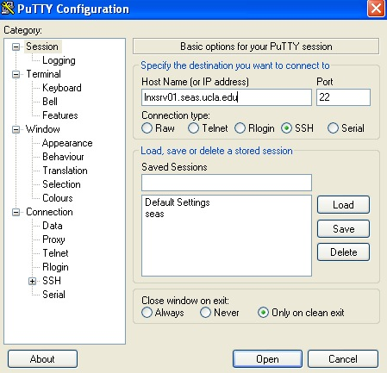
Connecting to SEAS from Windows
Putty
Recommended. Small and easy to use
Homepage: http://www.chiark.greenend.org.uk/~sgtatham/putty/download.html
Download: http://the.earth.li/~sgtatham/putty/latest/x86/putty.exe
Host name: lnxsrv.seas.ucla.edu, User name: your SEAS user name

Slide 30
Connecting to SEAS from OS X or Linux
Terminal
$ ssh username@lnxsrv.seas.ucla.edu
Username = your SEAS user name

